Slide 1

WINE QUALITY PREDICTION USING MACHINE LEARNING
Arnav Aggarwal
RA2111032010002
Navdeep Singh Jakhar
RA2111032010030

Slide 2


Agenda
Objective | 3
Abstract | 4
System Flow Diagram | 5

Slide 3

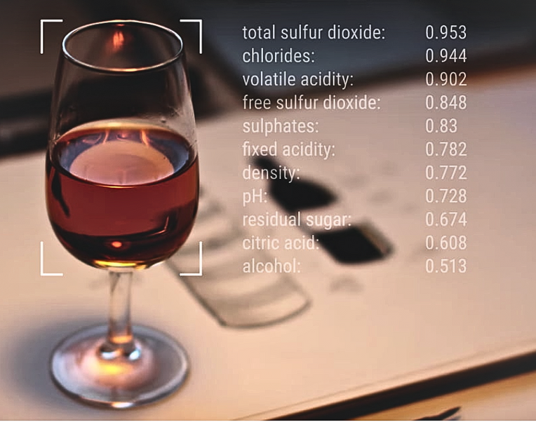
Objective
To develop an accurate and robust machine learning model that predicts the quality of red wines based on various features such as fixed acidity, volatile acidity, citric acid, density, pH, sulfates, alcohol, etc.
The goal is to leverage advanced data analysis techniques and use multiple classification algorithms. These models will be capable of assessing and classifying red wines into quality categories. Subsequently, we will select the best-performing model.

Slide 4


Abstract
Objective: Predict red wine quality using classification algorithms.
Dataset: Kaggle's Red Wine Quality dataset.
Algorithms: Seven classification algorithms tested, including Logistic Regression, KNN, SVC, Decision Tree, GaussianNB, Random Forest, and XGBoost.
Technologies: Utilizes Python libraries such as Pandas, NumPy, Matplotlib, Seaborn, and Scikit-Learn.
Evaluation: Algorithms compared based on accuracy scores, with hyperparameter tuning for optimization.
Outcome: Identifying the best-performing method for wine quality prediction.

Slide 5
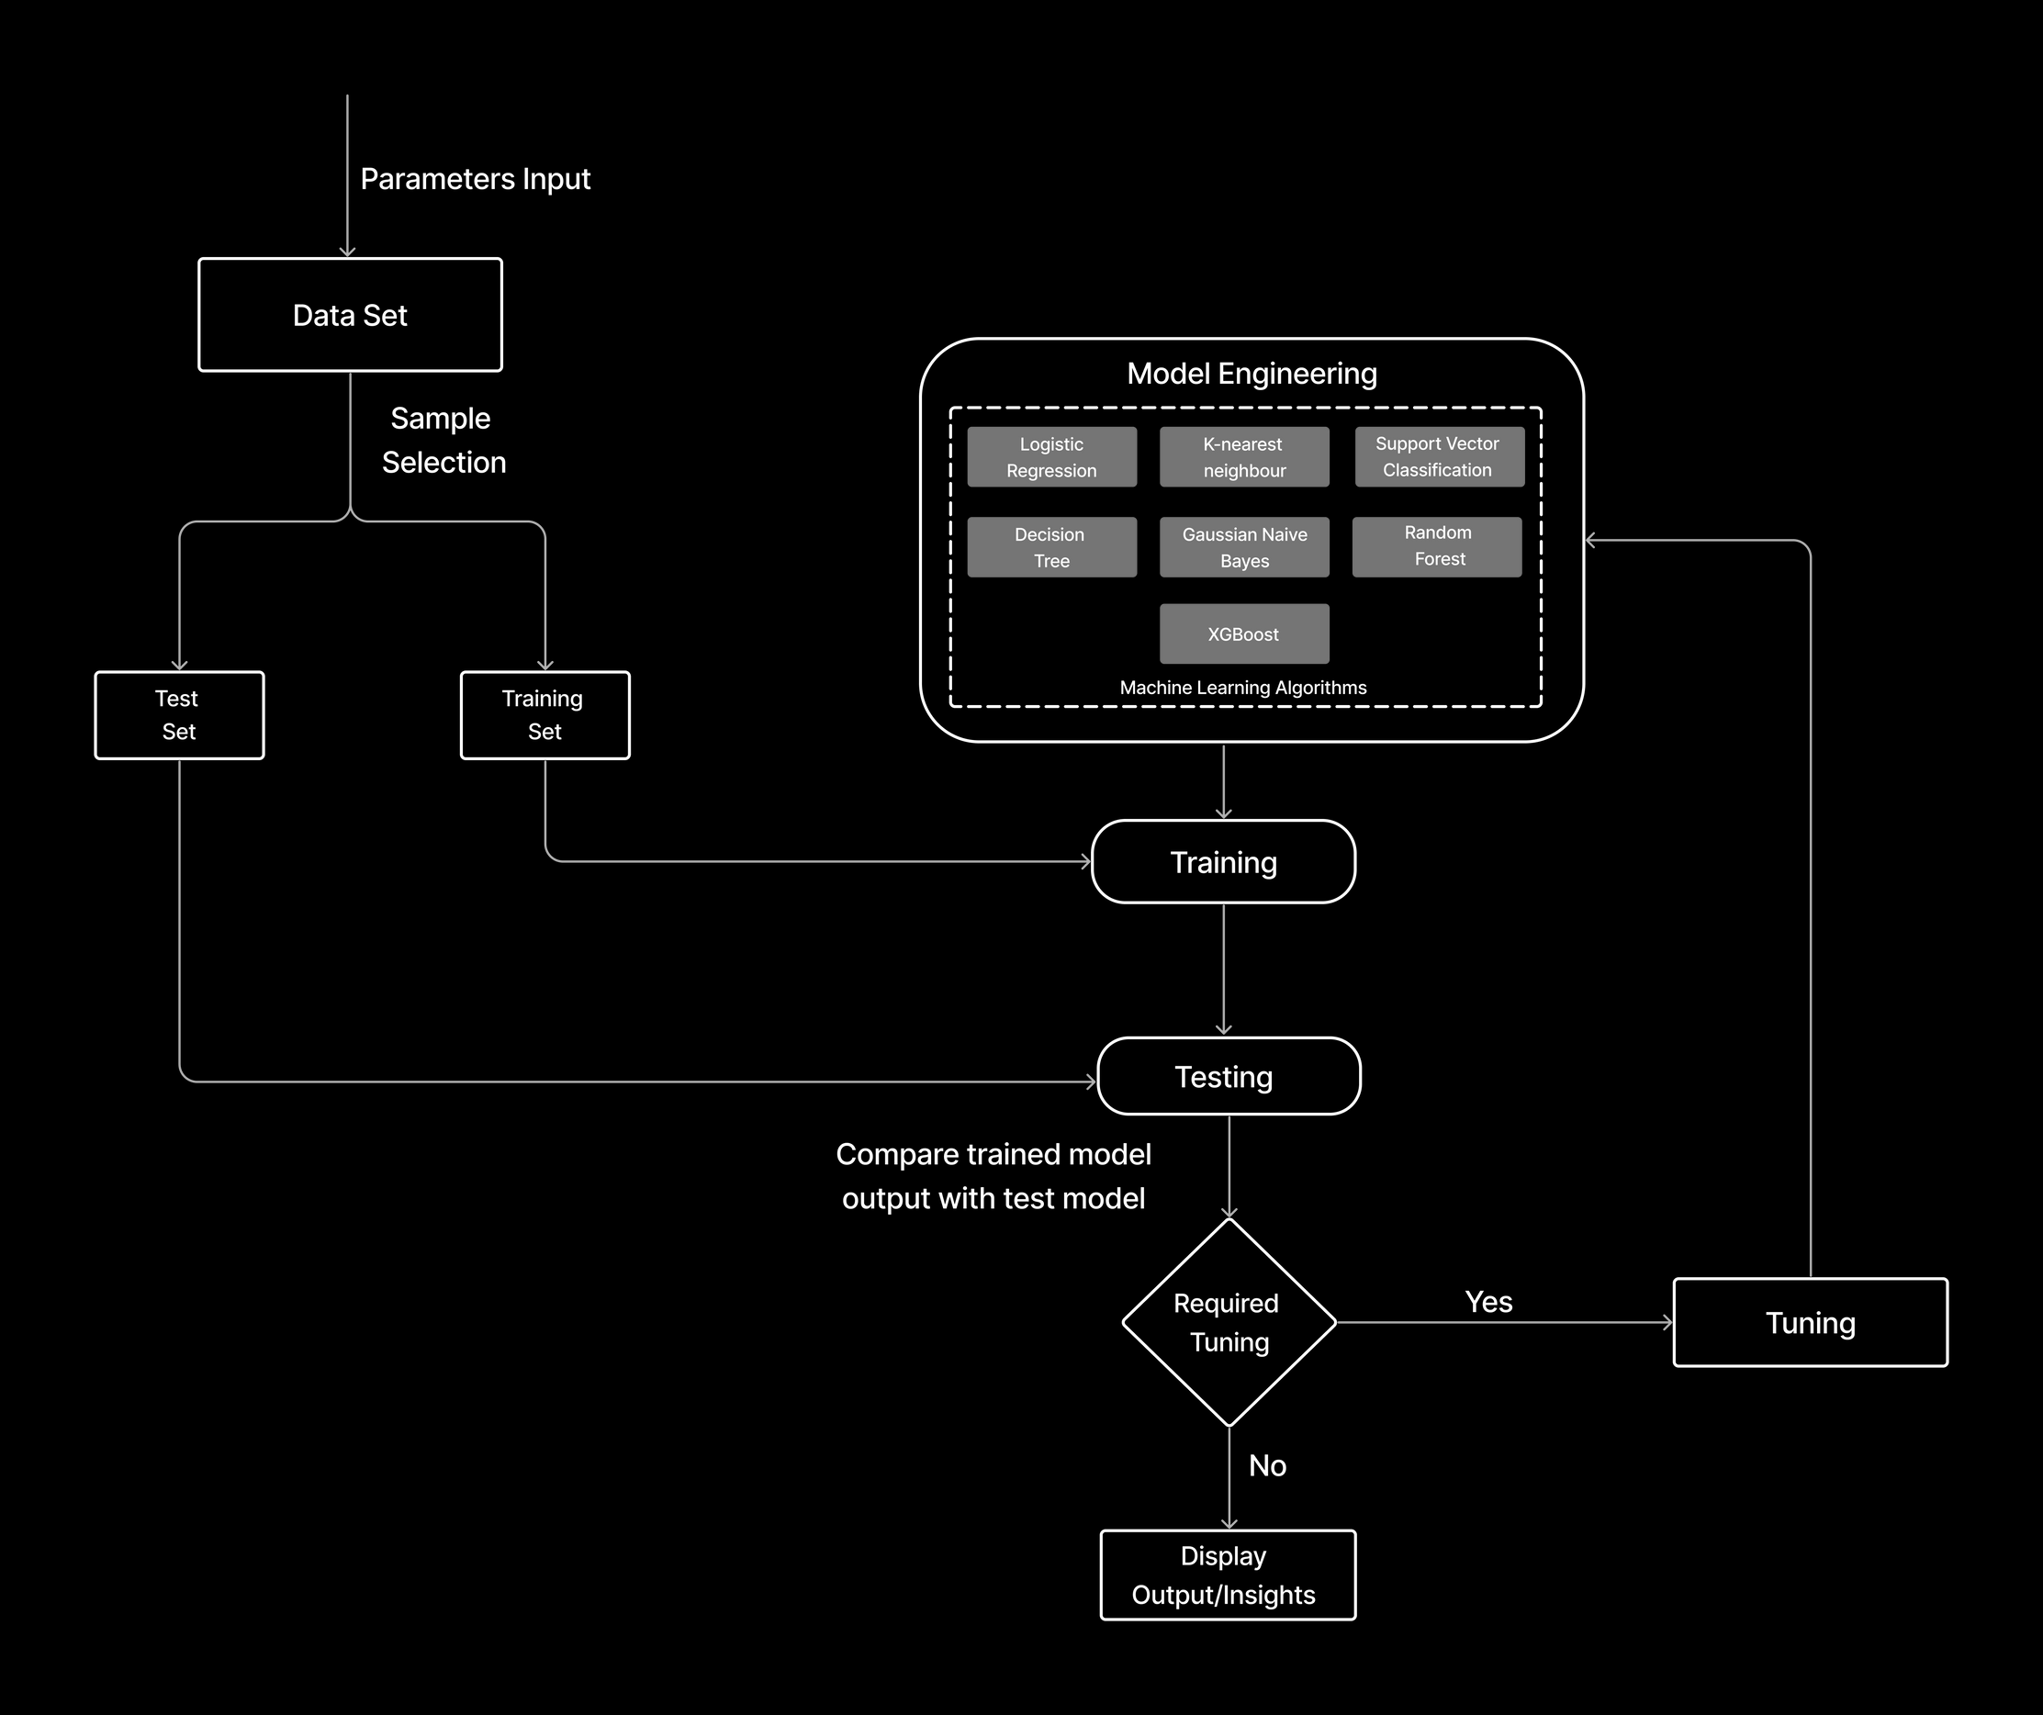

System Flow Diagram

Slide 6

Arnav Aggarwal
RA2111032010002
Navdeep Singh Jakhar
RA2111032010030
Thank you!

